Slide 1
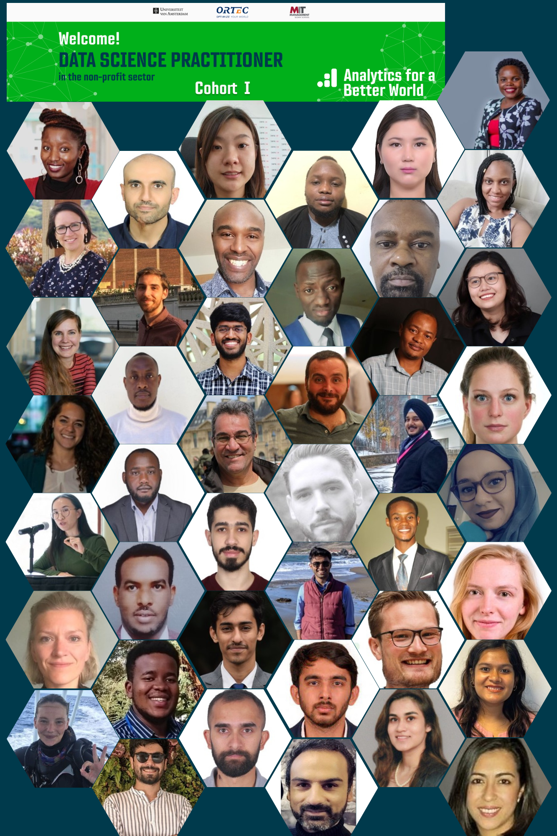
Data Science Practitioner
Fellowship Cohort 2022
Final Project Presentations – 6th December 2022
MAKING THE DATA PROCESSING AND VISUALIZATION WITHIN THE GRADUATION PILOT PROGRAM IN MONGOLIA
UNDRAM CHINGES, MONGOLIAN RED CROSS SOCIETY

Slide 2







Making the data processing and visualization within Graduation Pilot Program in Mongolia Mongolian Red Cross Society
Graduation Pilot Program in Mongolia
The Graduation Pilot Program will support 1,520 working-age adults aged 18–55 in poor households to build on cash transfers to provide holistic support that leads to economic inclusion, diversified livelihoods, and poverty reduction.
3627 households’ data collected
3 districts in Ulaanbaatar city
Targeting
1520 households
July 2022 – Dec 2023

Slide 3
Business Case
Problem:
We had data from 3627 households. But
Lack of knowledge on cleaning and preparing the data for analysis;
Lack of knowledge on visualizing the data to understand it;
Goal:
To determine and apply methods that could further process through working on the Big data of the Household Verification Survey of the Graduation Pilot Program and performing analysis and data visualization on the data;

Slide 4

Methods or Tools Used
Kobo Toolbox
Data collection
Excel
Data quality check
Data cleaning
Power Bi
Data analysis
Data visualization

Slide 5
Most Significant Change (can be a forecast)
For the work I do:
Support us to understand the current context and the situation of the households and basic of the program implementation;
Influence on the program direction and focus;
Contribute to the establishment of model program which can be implemented in the future;
For my organization:
Strengthen the human resource capacity;
For the Sustainable Development Goals:
Contribute to the SDG 1 – No poverty;

Slide 6
Key Learnings
Data cleaning
Data analysis
Data visualization

Slide 7
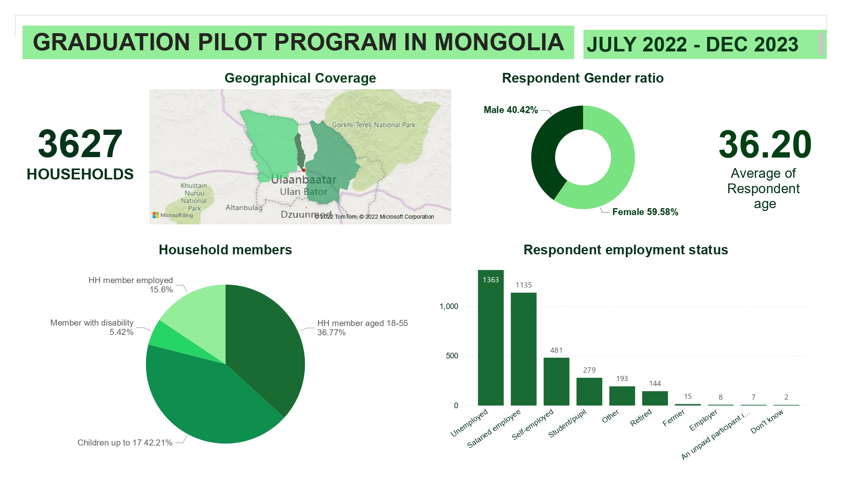

Slide 8
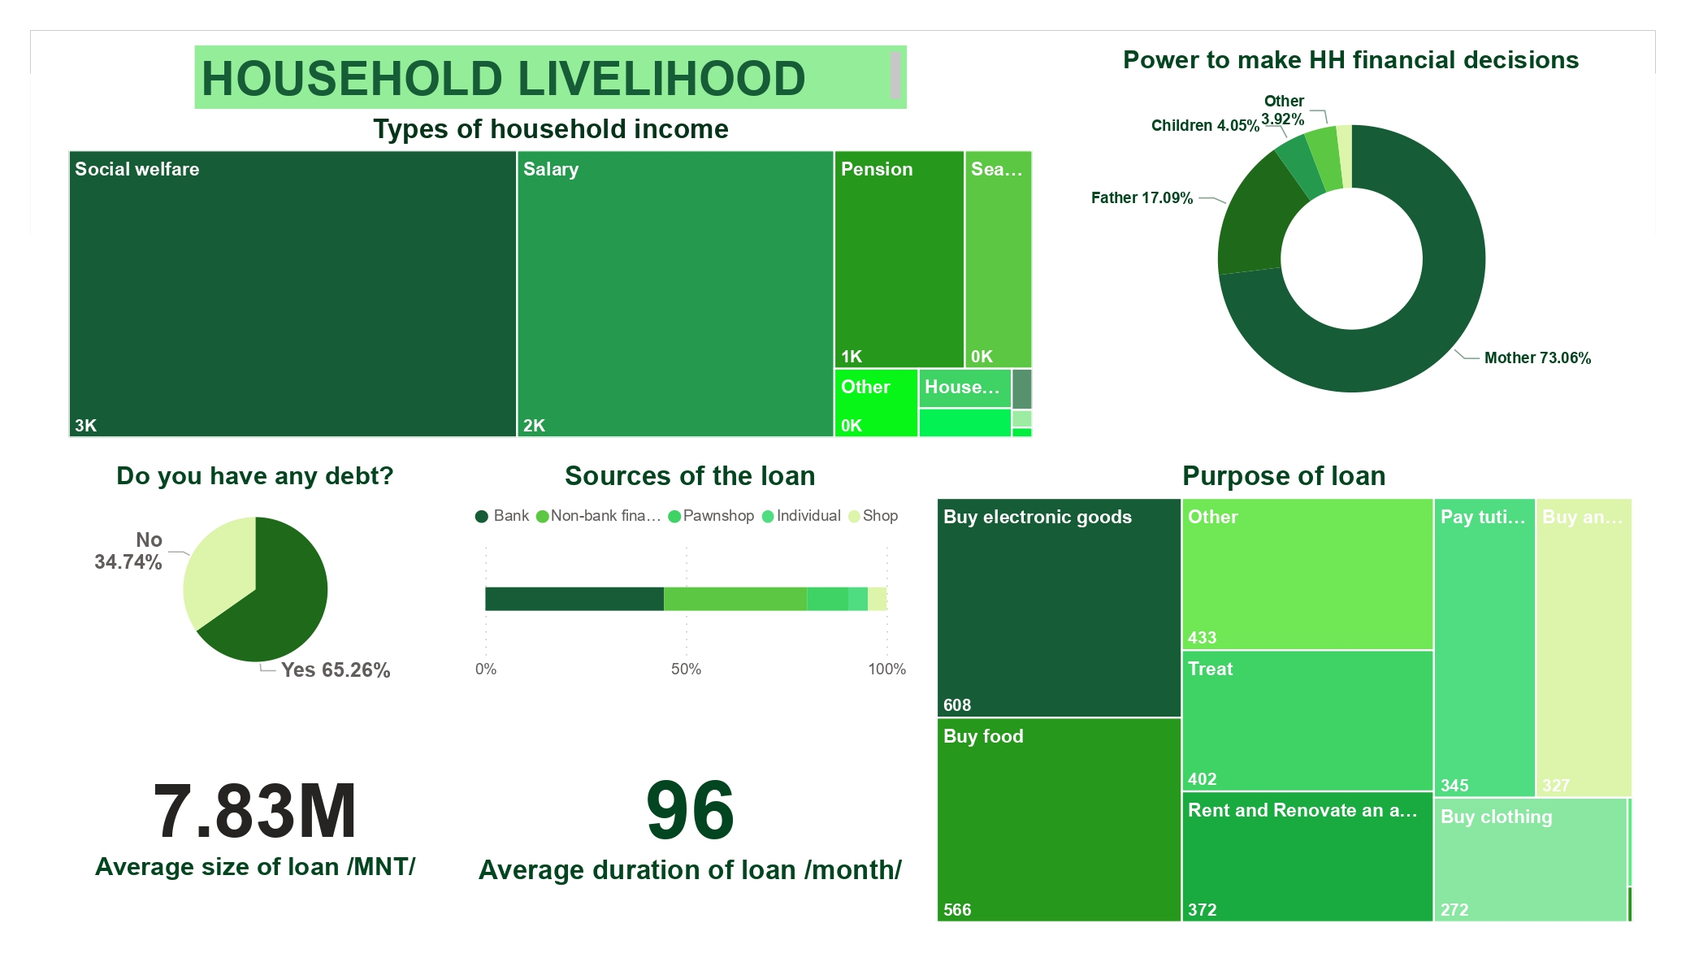

Slide 9
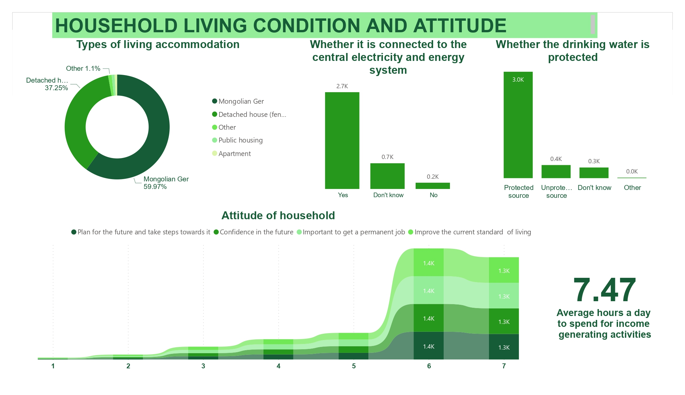

Slide 10
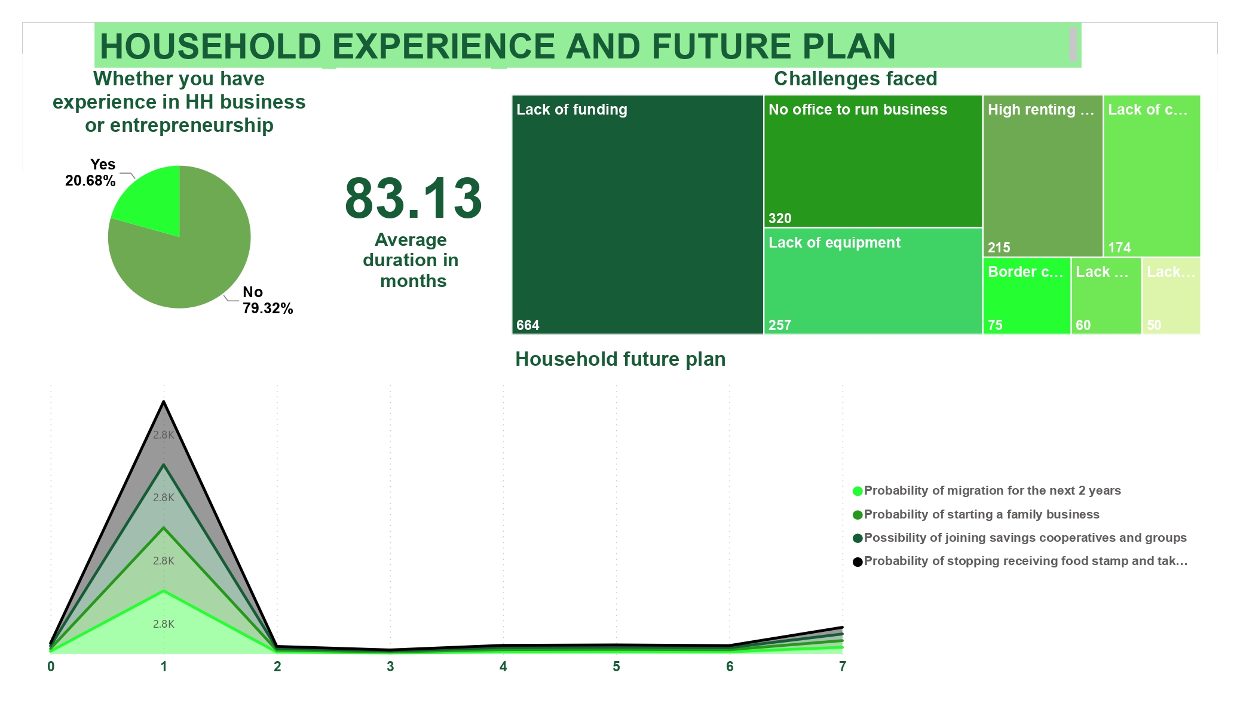

Slide 11
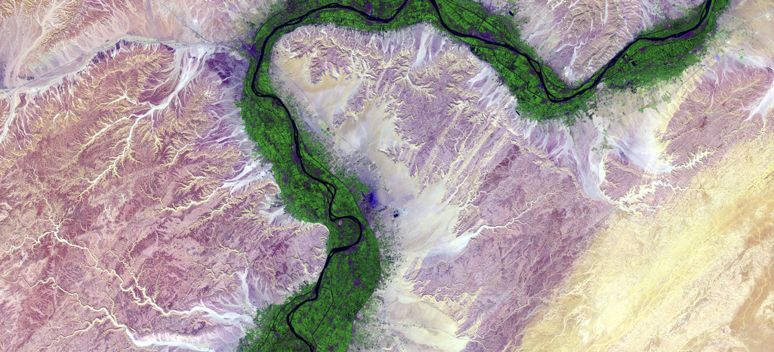
Thank you for your attention!
https://analyticsbw.org/
https://www.linkedin.com/company/analytics-for-a-better-world/
academy@analyticsbetterworld.org

